Slide 1
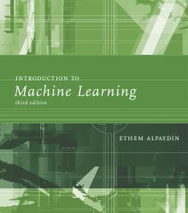
INTRODUCTION TO Machine Learning 3rd Edition
Lecture Slides for
ETHEM ALPAYDIN
© The MIT Press, 2014
alpaydin@boun.edu.tr
http://www.cmpe.boun.edu.tr/~ethem/i2ml3e

Slide 2
CHAPTER 5: Multivariate Methods

Slide 3
Gaussian Mixture Model (GMM)
One of the most powerful tool for statistical machine learning.
GMM and its variants perform state-of-the-art in countless tasks. Still unbeatable.
The definition is simple:
Any data distribution can be estimated using weighted sum of Gaussian distributions.
And yes, this is true

Slide 4
Gaussian Mixture Model (GMM)
Till now, we tried to fit either Bernoulli, Multinomial or Gaussian distribution to the data.
This mean, we assume that data (training or test) is drawn from these distribution.
This is very strict assumption.
Naturally, data can have arbitrary distribution and it does most of the time.

Slide 5
Gaussian Mixture Model (GMM)
For example, if we fit Gaussian distribution to the following data. It may not fit at all.

Slide 6
Gaussian Mixture Model (GMM)
So, lets try mixture of Gaussians i.e., K = 2 and d = 1

Slide 7

Gaussian Mixture Model (GMM)
Same is true for multi-dimensional data i.e., d > 2

Slide 8
Gaussian Mixture Model (GMM)
Do not confuse K with d. They are independent of each other. You can use any number of K for any value of d.

Slide 9
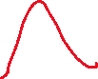

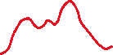
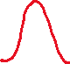
Gaussian Mixture Model (GMM)
Lets define GMM: A weighted sum of Gaussians
(1)

Slide 10
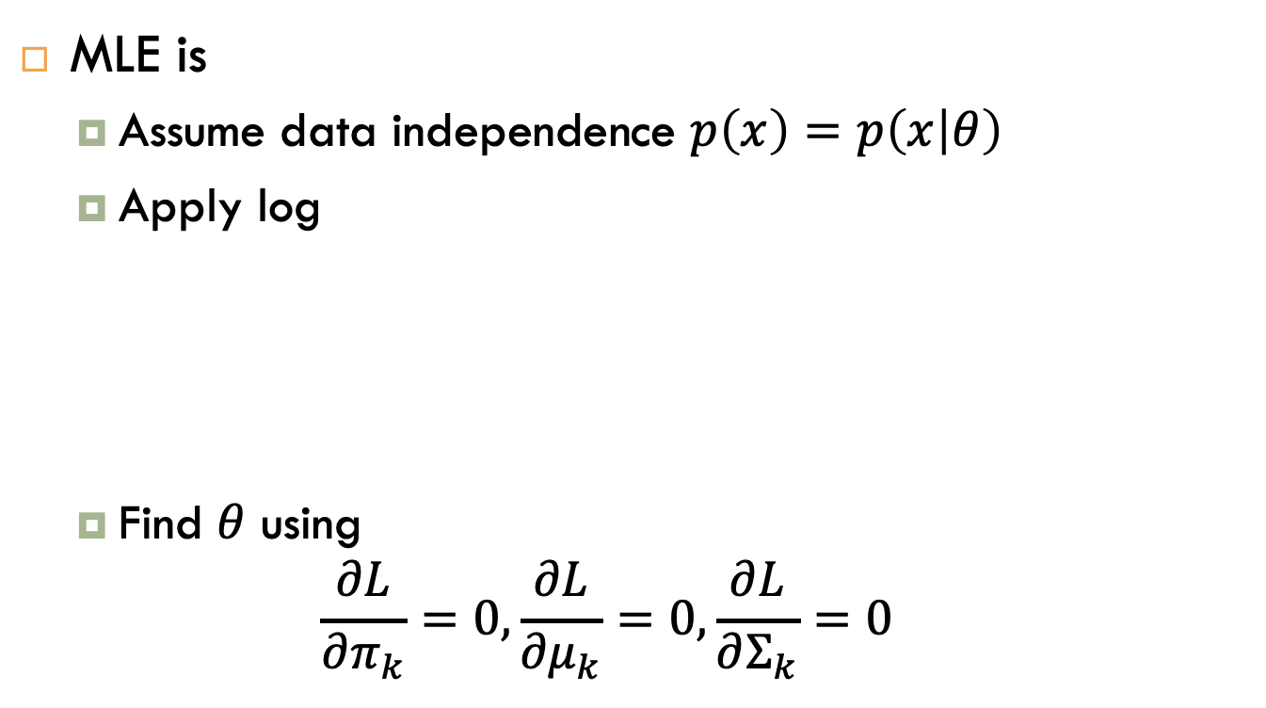
Gaussian Mixture Model (GMM)
MLE is
Assume data independence $p\left(x\right)=p\left(x | θ\right)$
Apply log
Find $θ$ using
$$\frac{∂L}{∂π_{k}}=0, \frac{∂L}{{∂μ}_{k}}=0, \frac{∂L}{∂Σ_{k}}=0$$
L =
from (1)

Slide 11
Gaussian Mixture Model (GMM)
MLE is
Let’s define a hidden variable ‘z’ which defines, which Gaussian ‘k’ generated our data ‘x’ to form a cluster
L =
from (1)

Slide 12
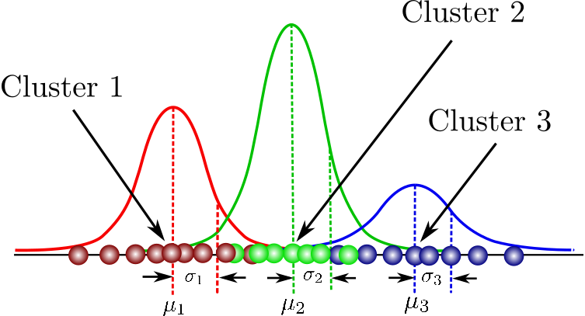

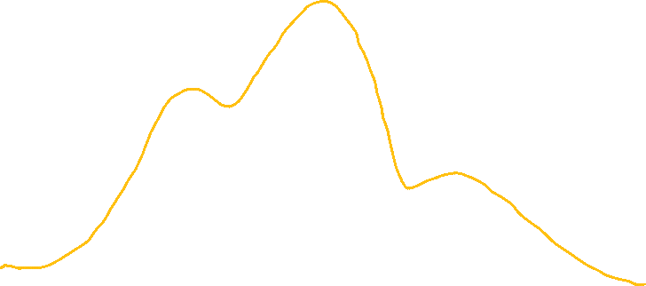
Gaussian Mixture Model (GMM)
Do not confuse clusters with classes

Slide 13
Gaussian Mixture Model (GMM)
Apply independence and log on this term now

Slide 14
Gaussian Mixture Model (GMM)
Cluster-wise mean
Cluster-wise variance
Cluster-wise weights

Slide 15
Gaussian Mixture Model (GMM)
Now the processes of finding partial derivatives is done with a new style called Expectation-Maximization (EM) algorithm.

Slide 16


Gaussian Mixture Model (GMM)
Optimisation using Expectation-Maximisation (EM) steps.
E-Step
Compute the posterior probability over z with initial model.
This is called responsibility of cluster k for x

Slide 17

Gaussian Mixture Model (GMM)
Optimisation using Expectation-Maximisation (EM) steps.
M-Step
Maximise the probability that it would generate the data it is responsible for
E-Step
M-Step

Slide 18

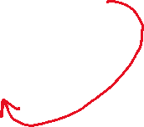

Gaussian Mixture Model (GMM)
Using Baye’s Rule

Slide 19
Gaussian Mixture Model (GMM)
Maximise w.r.t parmeters
With these updated parmameters, go back to E-Step

Slide 20


EM Summarised
(2)

Slide 21
EM Summarised

Slide 22
EM Summarised
How to initialise
Means to zero or mean vector of entire data (univariate or multivariate)
Covariance Matric to identity or using cov of entire data (univariate or multivariate)
Weights to 1/K each.

Slide 23
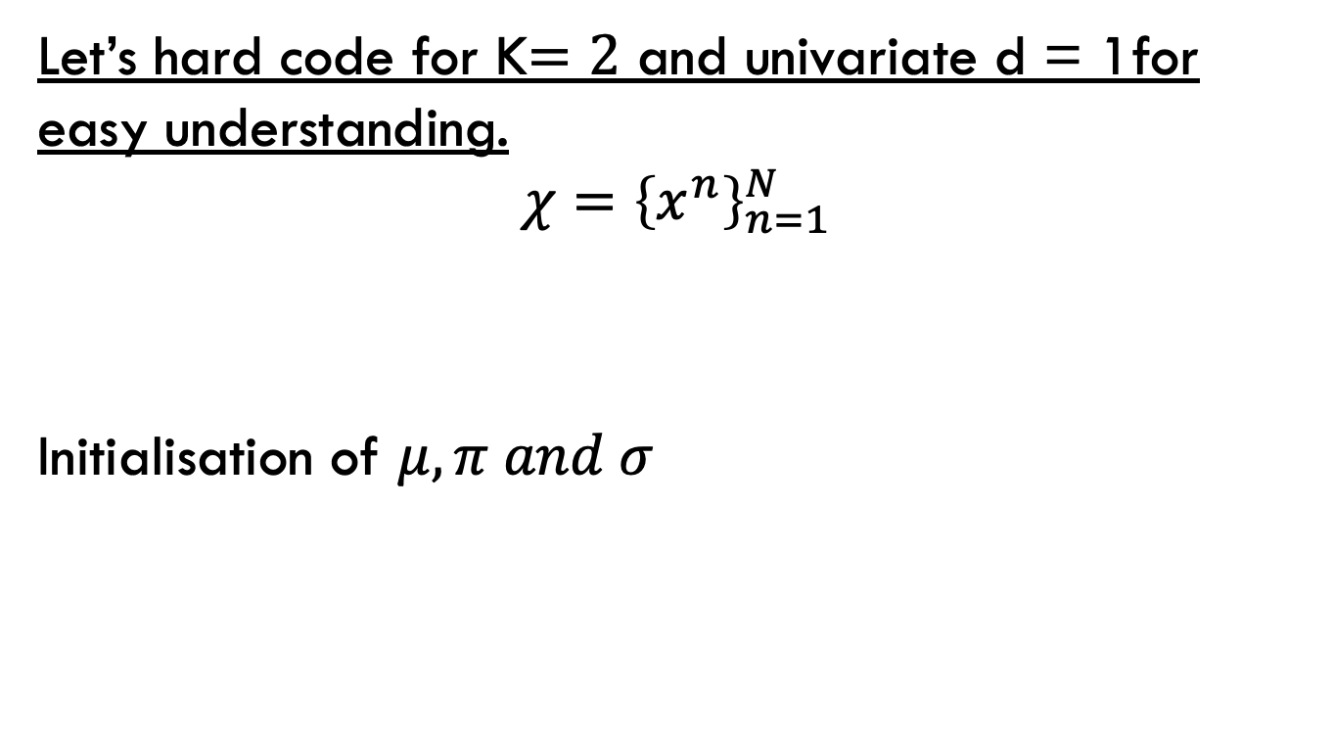
GMM-EM Coding
Let’s hard code for K$=2$ and univariate d = 1for easy understanding.
$$χ={\left\{x^{n}\right\}}_{n=1}^{N}$$
Initialisation of $μ,π and σ$
data = np.array([-0.39, 0.12, 0.94, 1.67, 1.76, 2.44, 3.72, 4.28, 4.92, 5.53, 0.06, 0.48, 1.01, 1.68, 1.80, 3.25, 4.12, 4.60, 5.28, 6.22])

Slide 24
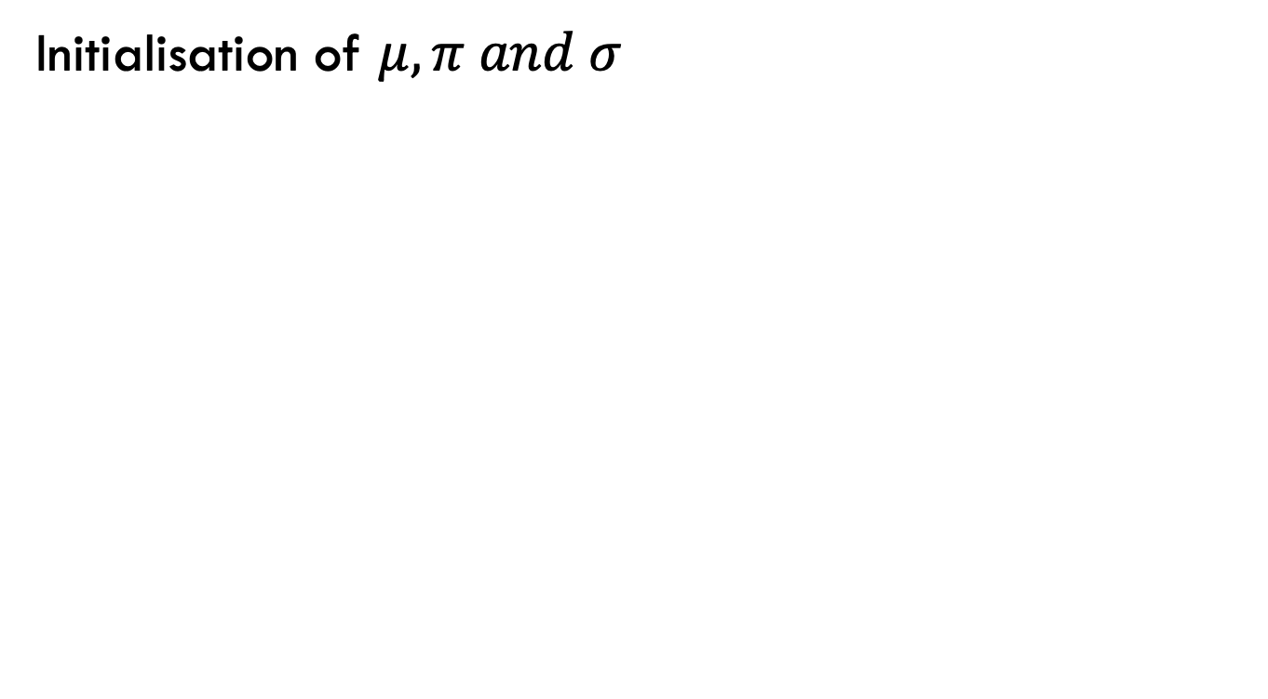
GMM-EM Coding
Initialisation of $μ,π and σ$
np.random.seed(42) # For reproducibility
temp = np.random.permutation(len(data))
piecap = np.zeros(201)
meucap1 = np.zeros(201)
meucap2 = np.zeros(201)
sigmacap1 = np.zeros(201)
sigmacap2 = np.zeros(201)
log_likelihood = np.zeros(201)
responsibilities = np.zeros((201, len(data)))
piecap[0] = 0.5
meucap1[0] = data[temp[0]]
meucap2[0] = data[temp[1]]
sigmacap1[0] = np.var(data)
sigmacap2[0] = np.var(data)

Slide 25
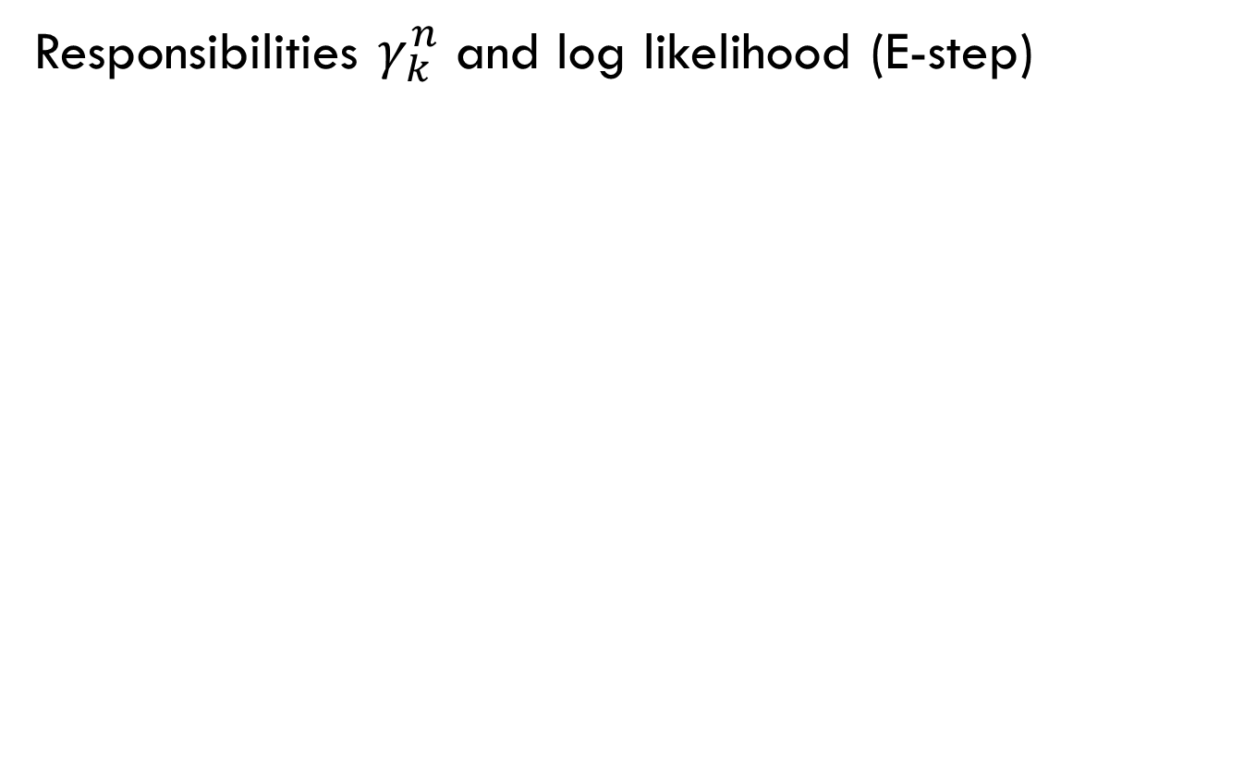
GMM-EM Coding
Responsibilities $γ_{k}^{n}$ and log likelihood (E-step)

Slide 26
GMM-EM Coding
Responsibilities $γ_{k}^{n}$ and log likelihood (E-step)
for i in range(200):
Qq1 = gauss_dist(data, meucap1[i], sigmacap1[i])
Qq2 = gauss_dist(data, meucap2[i], sigmacap2[i])
log_likelihood[i] = np.sum(np.log(((1 - piecap[i]) * Qq1) + (piecap[i] * Qq2)))
responsibilities[i, :] = (piecap[i] * Qq2) / (((1 - piecap[i]) * Qq1) + (piecap[i] * Qq2))

Slide 27
GMM-EM Coding
Updated parameters (M-step)

Slide 28
GMM-EM Coding
Updated parameters (M-step)
meucap1[i + 1] = np.sum((1 - responsibilities[i, :]) * data) / np.sum(1 - responsibilities[i, :])
meucap2[i + 1] = np.sum(responsibilities[i, :] * data) / np.sum(responsibilities[i, :])
sigmacap1[i + 1] = np.sum((1 - responsibilities[i, :]) * ((data - meucap1[i]) ** 2)) / np.sum(1 - responsibilities[i, :])
sigmacap2[i + 1] = np.sum(responsibilities[i, :] * ((data - meucap2[i]) ** 2)) / np.sum(responsibilities[i, :])
piecap[i + 1] = np.sum(responsibilities[i, :]) / len(data)

Slide 29
GMM-EM Coding
Plotting and seeing the convergence of likelihood
def gauss_dist(x, meu, sigma):
return (1 / (np.sqrt(2 * np.pi * sigma))) * np.exp(-((x - meu) ** 2) / (2 * sigma))
x = np.arange(-1, 7.1, 0.1)
norm1 = gauss_dist(x, meucap1[-1], sigmacap1[-1])
norm2 = gauss_dist(x, meucap2[-1], sigmacap2[-1])
plt.figure()
plt.hist(data, bins=10, density=True)
plt.plot(x, norm1)
plt.plot(x, norm2)
plt.show()
plt.figure()
plt.plot(log_likelihood[:199])
plt.xlabel('Iteration')
plt.ylabel('Observed Data Log-likelihood')
plt.grid()
plt.show()

Slide 30
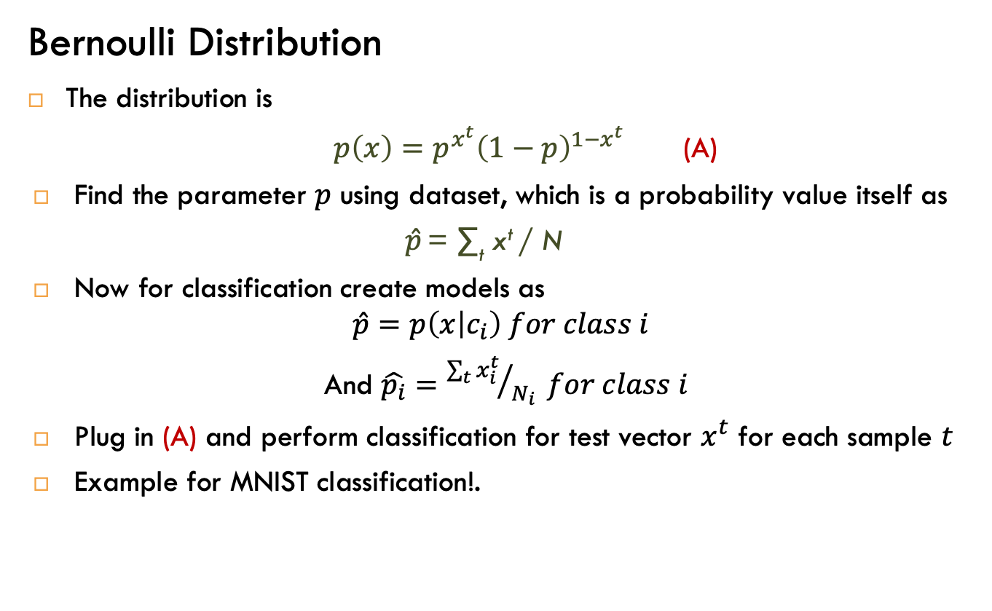
Classification, a look back
Bernoulli Distribution
The distribution is
$p\left(x\right)=p^{x^{t}}{\left(1−p\right)}^{1−x^{t}}$ (A)
Find the parameter $p$ using dataset, which is a probability value itself as
$\hat{p}$ = ∑_{t} x^{t} / N
Now for classification create models as
$$\hat{p}=p\left(x | c_{i}\right) for class i$$
And $\hat{p_{i}}={\sum_{t}{x_{i}^{t}}}/{N_{i}} for class i$
Plug in (A) and perform classification for test vector $x^{t}$ for each sample $t$
Example for MNIST classification!.

Slide 31
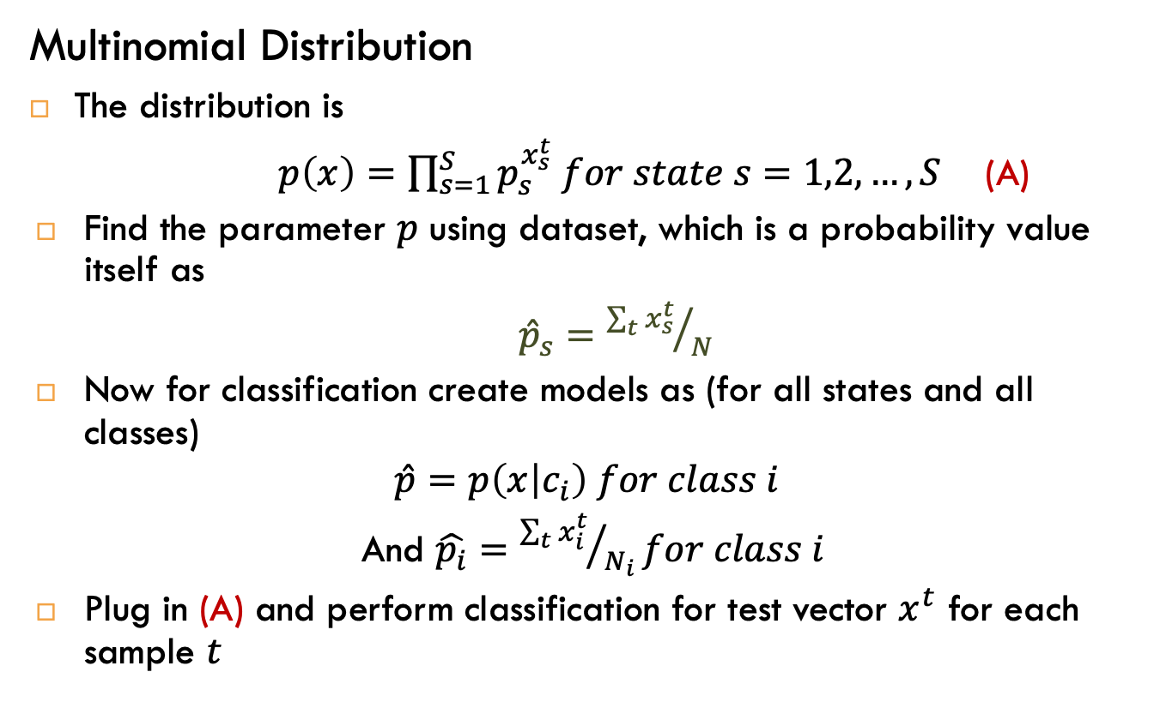
Classification, a look back
Multinomial Distribution
The distribution is
$p\left(x\right)=\prod_{s=1}^{S}{p_{s}^{x_{s}^{t}} for state s=1,2,…,S}$ (A)
Find the parameter $p$ using dataset, which is a probability value itself as
${\hat{p}}_{s}={\sum_{t}{x_{s}^{t}}}/N$
Now for classification create models as (for all states and all classes)
$$\hat{p}=p\left(x | c_{i}\right) for class i$$
And $\hat{p_{i}}={\sum_{t}{x_{i}^{t}}}/{N_{i}}for class i$
Plug in (A) and perform classification for test vector $x^{t}$ for each sample $t$

Slide 32
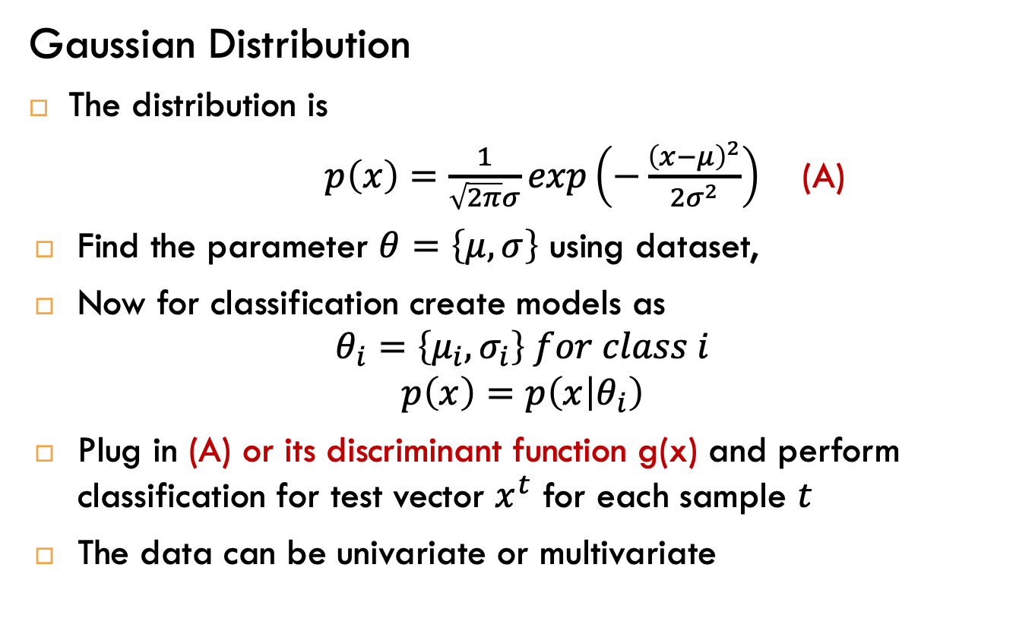
Classification, a look back
Gaussian Distribution
The distribution is
$p\left(x\right)=\frac{1}{\sqrt{2π}σ}exp\left(−\frac{{\left(x−μ\right)}^{2}}{2σ^{2}}\right)$ (A)
Find the parameter $θ=\left\{μ,σ\right\}$ using dataset,
Now for classification create models as
$$θ_{i}=\left\{μ_{i},σ_{i}\right\} for class i$$
$$p\left(x\right)=p\left(x | θ_{i}\right)$$
Plug in (A) or its discriminant function g(x) and perform classification for test vector $x^{t}$ for each sample $t$
The data can be univariate or multivariate

Slide 33
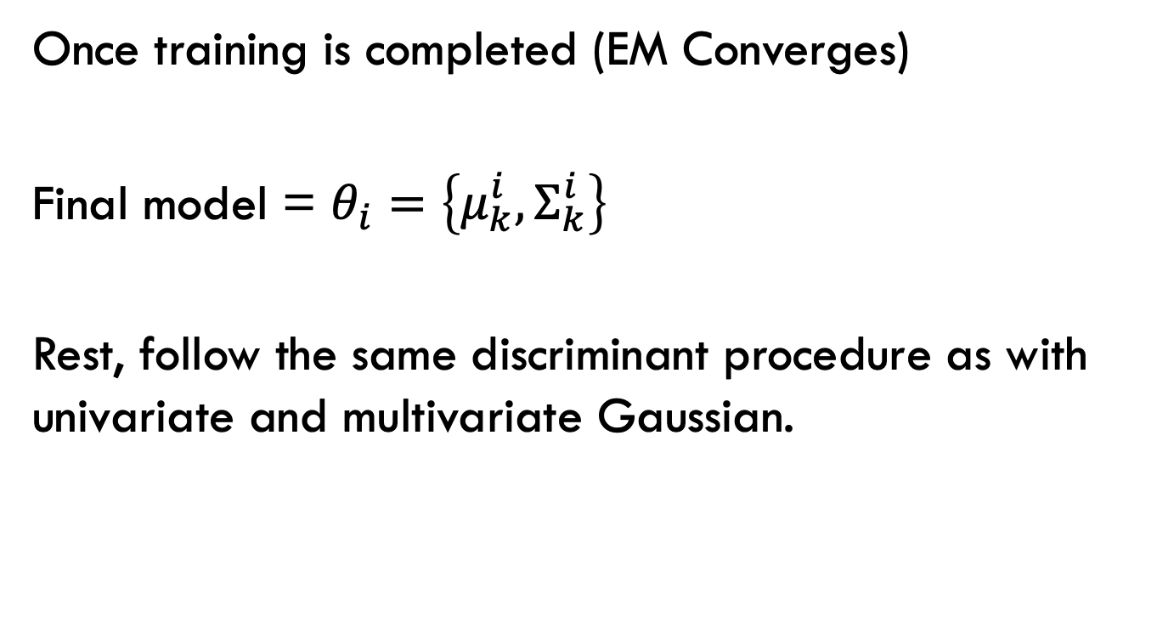
GMM Classification
Once training is completed (EM Converges)
Final model = $θ_{i}=\left\{μ_{k}^{i},Σ_{k}^{i}\right\}$
Rest, follow the same discriminant procedure as with univariate and multivariate Gaussian.
i is class, k is cluster

Slide 34









Eq (2)
Eq (2)
Assuming multivariate

Slide 35








